Slide 1
Binary, conditional and boolean

Slide 2
TABLE OF CONTENTS
01
02
03
Binary number
Boolean datatype and comparison operators
Conditional statement
04
Boolean operators

Slide 3
01
Binary number

Slide 4


The number system that we normally use is the decimal number system. It has 10 numbers: 0-9
The binary number system is a base-2 number system. This means it only has two numbers: 0 and 1
1
0
https://www.youtube.com/watch?v=ewokFOSxabs

Slide 5


How to represent information using Electricity?

Slide 6
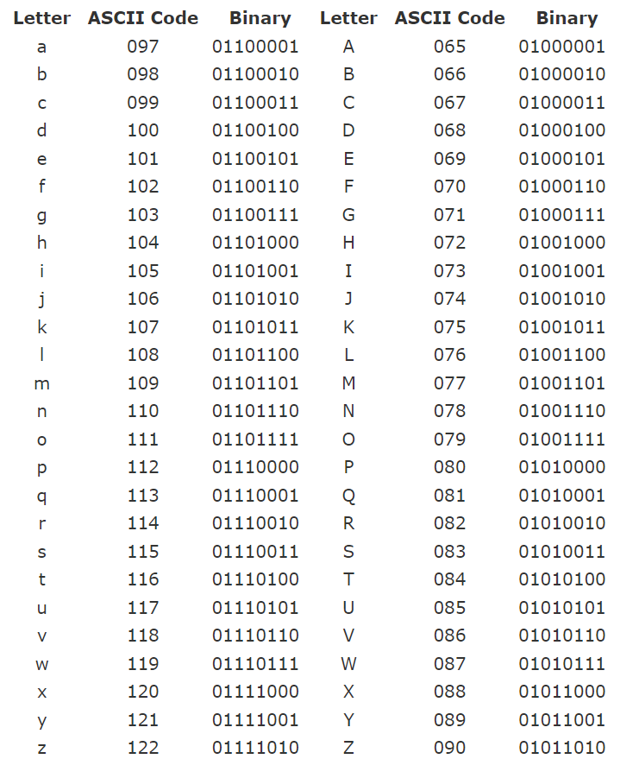

Slide 7
02
Boolean
Datatype and Conditional Operators

Slide 8
The boolean datatype
The computer talks in binary number, and every programming language allow programmers represent the logic with boolean data type with 2 values: True or False

Slide 9

Conditional operators
<
==
>
<=
>=
Lesser than
Equals to
Greater than
!=
Lesser or Equal to
Not equals to
Greater or Equals to
= operator is to assign variable
== operator is for equality comparison

Slide 10
03
Conditional statement with if

Slide 11
Definition
The if-else statement in Python allow you to perform actions based on some condition
Example: if you are older than 18, then you can watch the movie, else you can’t watch it

Slide 12
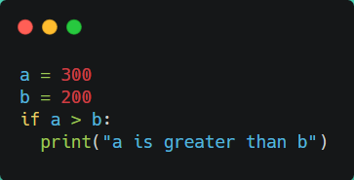
Syntax
if condition:
Statement if true
...
The condition can use any logical operator, as long as they result in true or false

Slide 13


Correct
Not correct
Python relies on indentation (whitespace or tab at the beginning of a line) to define scope in the code. Other programming languages often use curly-brackets for this purpose.
Not indenting inside if statement will result in an error
a = 33
b = 200
if b > a:
print("b is greater than a")
a = 33
b = 200
if b > a:
print("b is greater than a") # you will get an error

Slide 14
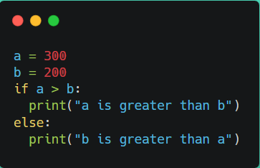
Syntax
if condition:
Statement if true
…
else:
Statement if false
...

Slide 15
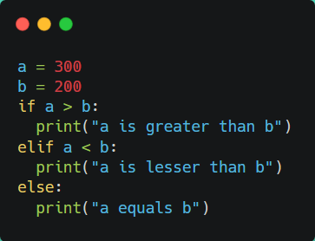
Syntax
if condition_1:
Statements if condition_1 is true
…
elif condition_2:
Statements if condition_2 is true
…
elif condition_3:
Statements if condition_2 is true
…
…
else:
Statements if none is true

Slide 16
04
Boolean operators

Slide 17
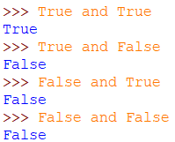
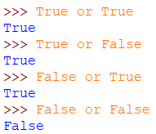

Boolean logic
and
or
not

Slide 18
Example of boolean logic with comparison operator
age = 20
money = 150
if age >= 18 and money > 200:
print("You are allowed to enter")
else:
print("Must must be over 18 and money over 200 in order to enter")
age >= 18 (true)
money > 200 (false)
age >= 18 and money > 200 (false)
=> Must be over 18 and money over 200 in order to enter

Slide 19


Slide 20
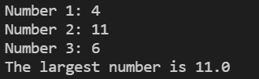



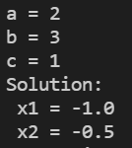
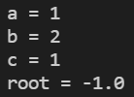

Write a program to find largest of three given numbers a, b, c.
(a,b,c are real number)
Write a program to check if a year is a leap year or not.
- A leap year is exactly divisible by 4 except for century years (years ending with 00). The century year is a leap year only if it is perfectly divisible by 400.
- For example: 1999 is not a leap year
2000 is a leap year
2004 is a leap year
Write a program to find the real roots of a quadratic equation:
ax² + bx + c = 0
(a,b,c are real numbers and a != 0)

Slide 21
THANKS!
See you in the next lesson!

